Slide 1
COURIER MANAGEMENT SYSTEM
PRESENTED BY MANJUNATH PATIL,MAHMDASABIR DHARWAD
BSC CS 6TH SEMESTER

Slide 2
PROBLEM DEFINITION OF THE EXISTING SYSTEM
People when transfer their products using any courier service wants to know whether their product has been shifted to their right place or not, if not then by what time it will be shifted and where it is now. Taking all this information manually is very difficult and time taking process. To handle all these activities include various processes and paper work from the management side also.

Slide 3
INTRODUCTION
This Courier Management System Project will have different modules. The login section will have login facility for the admin and for the user who will operate this system. While taking orders from its customers, it will take all the details of its customers who is placing the orders and all the details for the recipient such as its address, name, mobile number. During billing process system will generate a tracking id for their products. Through this tracking id, customers or its recipient will able to track their products from any location using internet. It will provide status of the product after placing orders .

Slide 4
OBJECTIVES
Decrease the load of the person involve in existing manual system.
Access of any information individually.
Work becomes very speedy.
Easy to update information.
It contains better storage capacity.
Well designed reports.

Slide 5
INPUT OUTPUT
ADMIN DETAILS
CUSTOMER DETAILS
SHIPPING DETAILS
ADMIN PROFILE
CUSTOMER PROFILE
PARCEL DETAILS
TRANSACTION REPORTS
BILLING REPORTS

Slide 6
BASIC MODULES
Admin Management
Customer Management
Parcel Management
Goods Management
Tracking Management

Slide 7
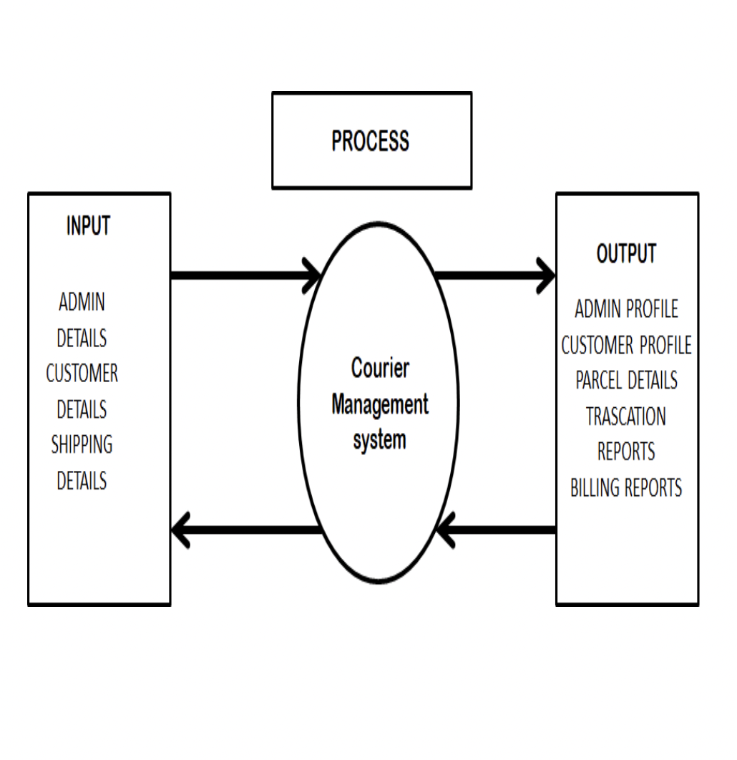
PROCESS LOGIC
CONTEXT LEVEL DFD

Slide 8
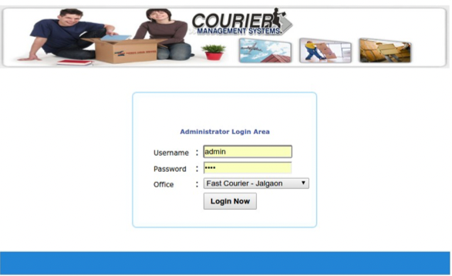
MOCKUPS
ADMIN LOGIN

Slide 9
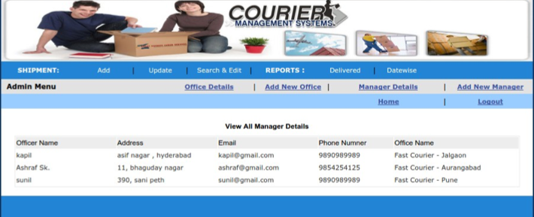
MOCKUPS
DASHBOARD

Slide 10
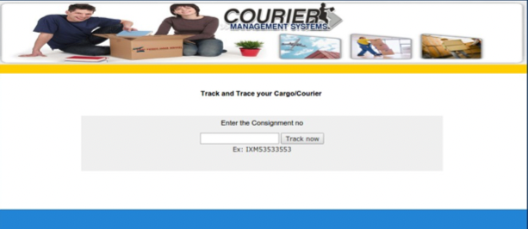
MOCKUPS
TRACKING PAGE

Slide 11
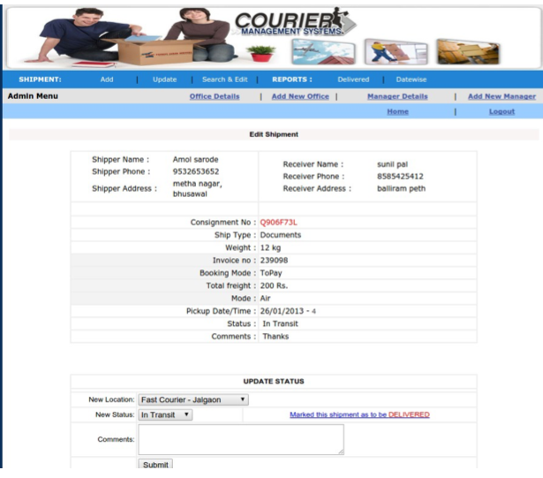
MOCKUPS
SHIPMENT DETAILS

Slide 12
HARDWARE REQUIREMENTS
Processor : core intel i3 or M1 Chip
RAM : 4GB and More
Hard Disk : 120GB and More
Operating System : Windows 7 or Mac os

Slide 13
SOFTWARE REQUIREMENTS
FRONTEND:
HTML , CSS
MIDDLE WARE:
PHP , JAVASCRIPT
BACKEND:
MYSQL

Slide 14
TOOLS AND PLATFORM
WEB SERVER:
XAMPP
BROWSER:
GOOGLE CHROME
PLATFORM :
VISUAL STUDIO CODE (IDE)

Slide 15
LIMITATIONS OF THE PROJECT
General limitations of a project, including time, costs and risks.
At present the website is not able to provide online payments.
Optional route measure are not available now.
Sometimes there is slow page loading problem.

Slide 16
SCOPE/FUTURE APPLICATION
Online payments will be available.
The page loading error will be resolved.
Optional route measure will be provided.

